Slide 1


Extramus Partnership Proposal
Connecting Companies with Interns & Creating New Opportunities

Slide 2
Executive Summary
Extramus connects young talents with companies.
New model: Shift from Franchise to Partnership.
Goal: Provide extra value to companies (website, interns, social vision).
Long-term: Explore visionary projects via Google Non-Profit and similar sources.

Slide 3
Our Services
Website Creation – build professional, affordable websites for companies.
Internship Placement – match companies with suitable interns.
Visionary Collaboration (Social Projects) – support social initiatives, leverage Google Non-Profit.

Slide 4
Value Proposition
For Companies: Visibility, access to talented interns, social prestige.
For Interns: Real-world experience, project-based learning.
For Extramus: Wider business network, sustainable model.

Slide 5








Our Partnership Process
Identify Potential Partners
Research NGOs, SMEs, municipalities, Erasmus+ networks.
Outreach
Email/LinkedIn + short pitch deck.
Needs Assessment
15-min call or form to understand partner’s intern needs, duration, and skills required. .
Proposal & Pricing
Offer tailored placement package (fixed fee or tiered
Pilot Placement
Match first interns.
Feedback & Refinement
Partner feedback on intern quality, process ease, and communication. use to improve matching, pricing, and comms.
Scale Outreach
Apply refined model to 10–20 more partners

Slide 6





Internship Placement
Step 1
Extramus reaches out the candidate companies.
Step 2
Extramus sources and screens potential interns.
Step 3
We match and introduce the intern to the organisation.
Step 4
Organisation and intern finalise the agreement. Extramus steps back. Our services ends here.

Slide 7

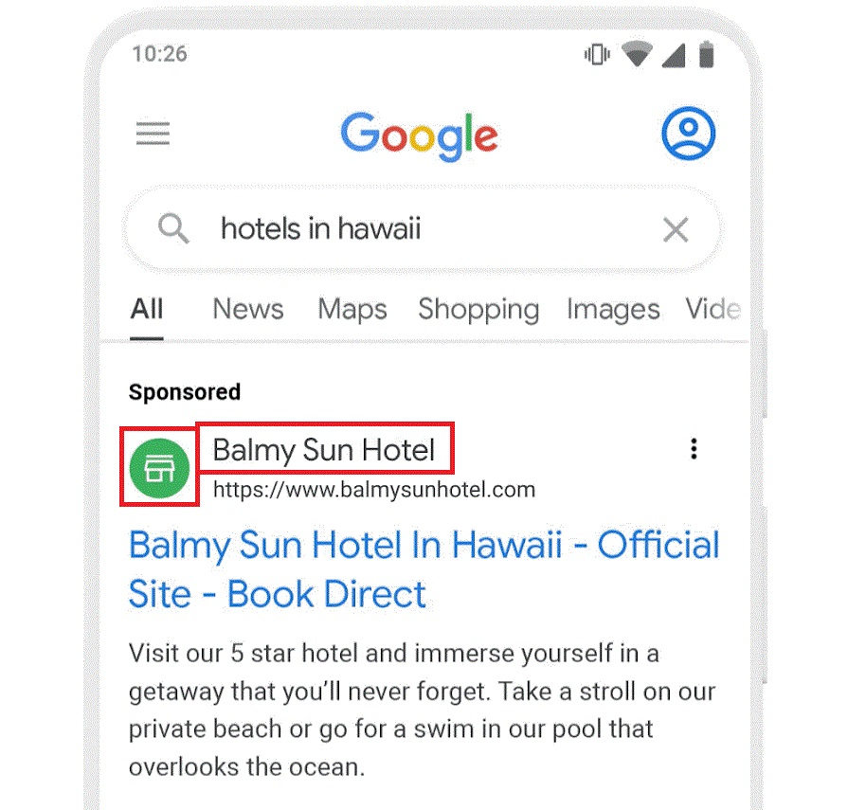
Social Projects
Google Ad for Non-Profit Organizations
Google offers ad grant for non-profits amount of $10,000 for every month.
This is specifically for search ads.

Slide 8
Benefits of Google Ad Grant
$10,000 ad grant a month
You don’t have to pay for branded email
You can create a fundraiser in the youtube platform
Free storage through Google Drive (100TB free storage)

Slide 9
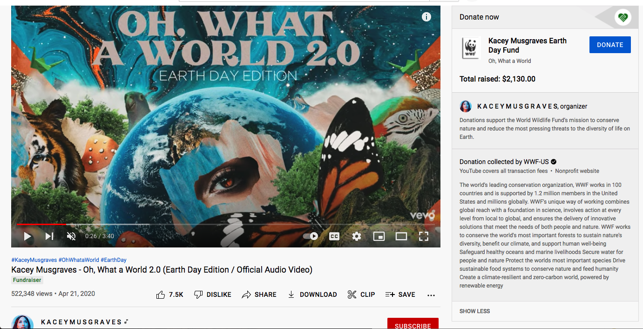

Slide 10
Service Estimation (Scenario Analysis)
10
3
€250
Interns Placed
Months
Per Intern
Monthly placement target
Average placement duration
Average monthly income
Our program places 10 interns per month with an average placement duration of 3 months, generating an average income of €250 per intern monthly.
Note: The numbers are representative, it doesn’t show the real-world scenario

Slide 11
Sector-Based Pricing (15% Share)
IT Roles
Business Roles
Other Roles
Front-End & Back-End Developer Interns
HR, Data Analyst, Product Manager
Marketing, Languages, Urban Design, Law
Productivity Value: €300/month
Productivity Value: €250/month
Productivity Value: €150-200/month
Extramus Fee: €45/month
Extramus Fee: €37.50/month
Extramus Fee: €22.50-30/month
At a 15% share (moderate case), our total monthly revenue increases to €352.50 across all sectors.
Note: The numbers are representative, it doesn’t show the real-world scenario

Slide 12

Financial KPIs
Revenue per Placement
Target: €250.00
Gross Margin
Target: >90%
Little to no cost for the placement process
Note: The numbers are representative, it doesn’t show the real-world scenario

Slide 13
Operational KPIs
Number of Placements
Time-to-Fill
Target: 10 per month
Target: <3 weeks
How much time it takes to match interns with companies
Success Rate
Retention Rate
Target: >85%
Target: >80%
How many applicants are successfully placed
Partner company retention
These operational metrics help us track efficiency and effectiveness of our placement process.
Note: The numbers are representative, it doesn’t show the real-world scenario

Slide 14

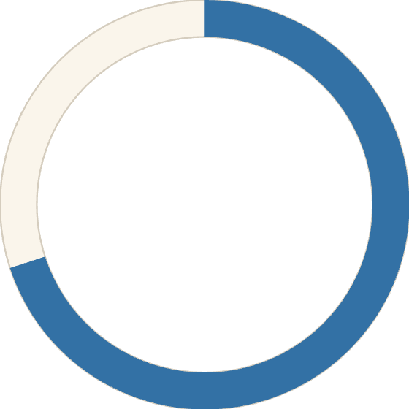
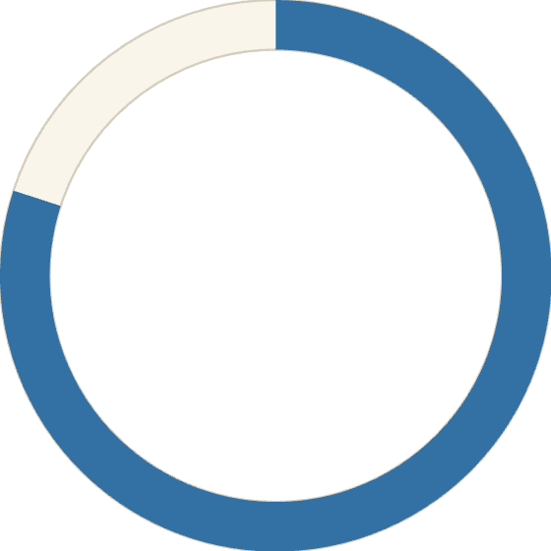
Partner KPIs
Key Partner Metrics
70%
Repetition Rate
Target for companies requesting interns from Extramus again
8/10
Satisfaction Score
Target partner satisfaction rating
Note: The numbers are representative, it doesn’t show the real-world scenario

Slide 15
Financial Proposal
Website Creation: €XXX – €XXX (one-time).
Internship Placement Fee: €XXX per intern.
Social Projects: Pro bono / grant-supported (e.g. Google Non-Profit).
Note : The numbers will be finalized after the test launch.

Slide 16
Next Steps
Select 2–3 pilot companies.
1
Test services and gather feedback.
2
Refine and improve the model.
3
Reconsider franchise or social franchise opportunities in the long term.
4

